Slide 1
Creating tickets

Slide 2


Ticket created
Ticket with a runID (from a job)
Ticket without a runID (agent unavailable)

Slide 3
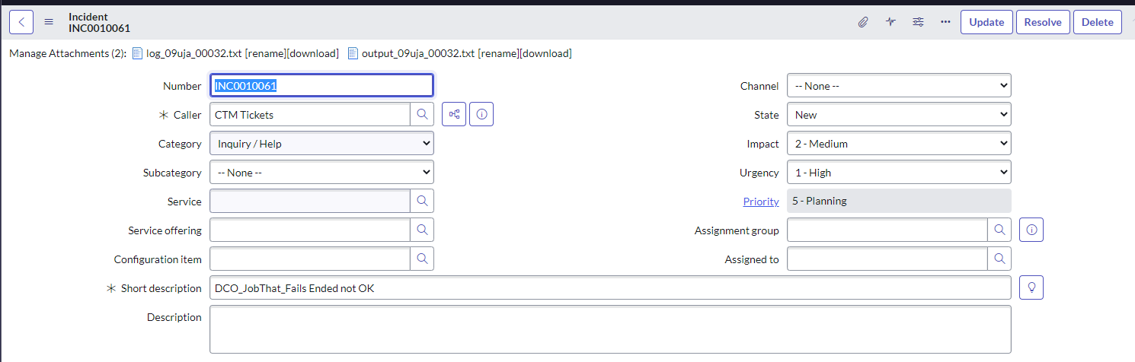
Ticket with a runID Notice log and output attached

Slide 4
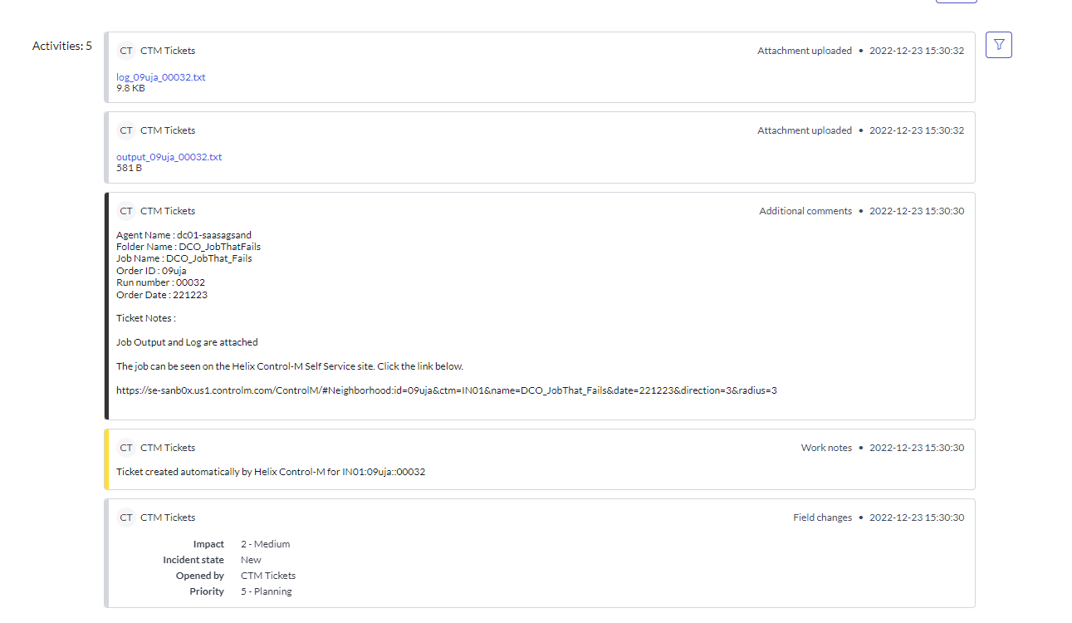
Ticket with a runID

Slide 5
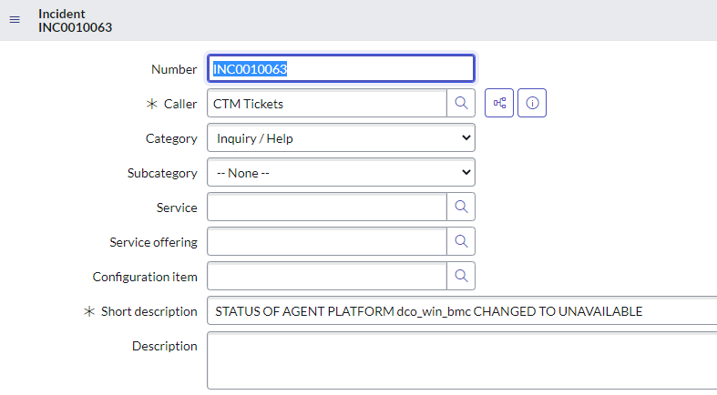
Ticket without a runID

Slide 6
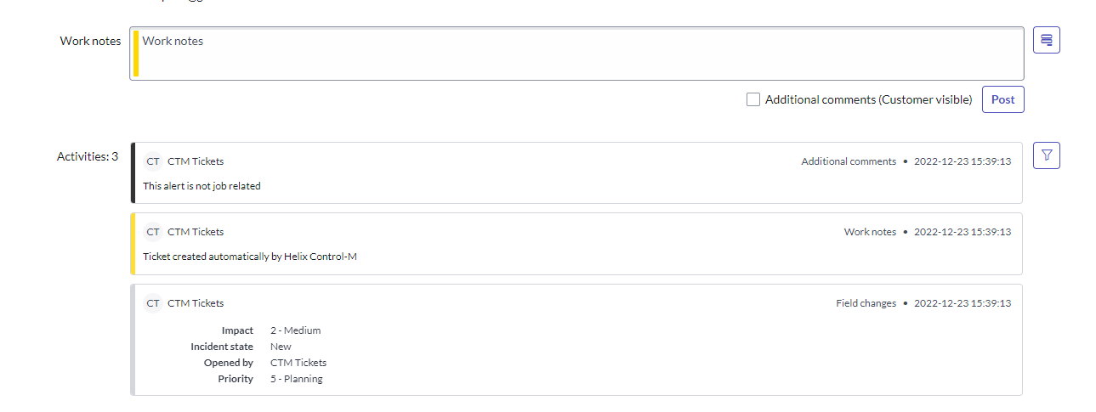
Ticket without a runID

Slide 7
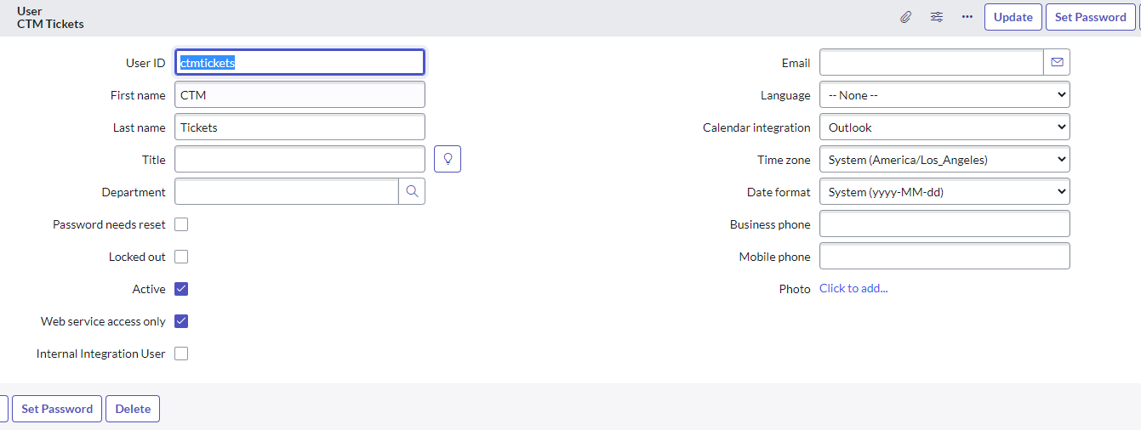
User

Slide 8
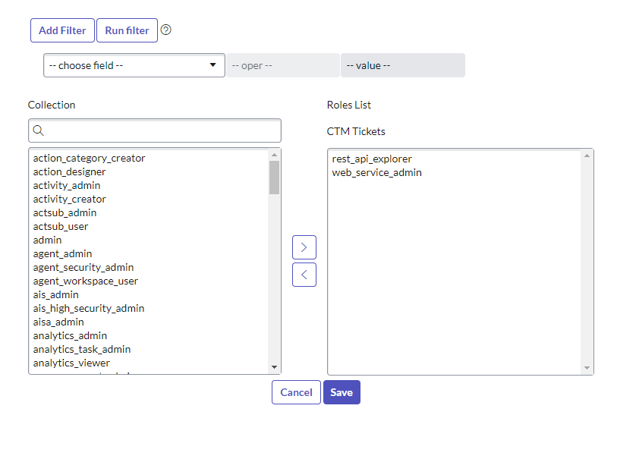
Roles

